Slide 1

Student-Teacher Appointment Booking System

Slide 2

Introduction
The appointment scheduling process between teachers and students is crucial. This presentation explores methods to enhance educational outcomes through effective scheduling practices, ensuring better communication and time management.

Slide 3

About
Streamline your educational journey with our efficient appointment booking system. Connect with teachers, schedule consultations, and enhance your learning experience and sending email notifications for updates.

Slide 4

Problem Statement
Booking appointment systems improve efficiency, reduce wait times, and boost productivity, especially in education.
Proposes a web-based system for students and lecturers to manage appointments online, enhancing communication, scheduling, and sending email notifications for updates.

Slide 5

Technologies Used:-
React JS
Tailwind CSS
Express JS
Node JS
MongoDB

Slide 6

System Modules :-
Admin Module
Teacher Module
Student Module

Slide 7
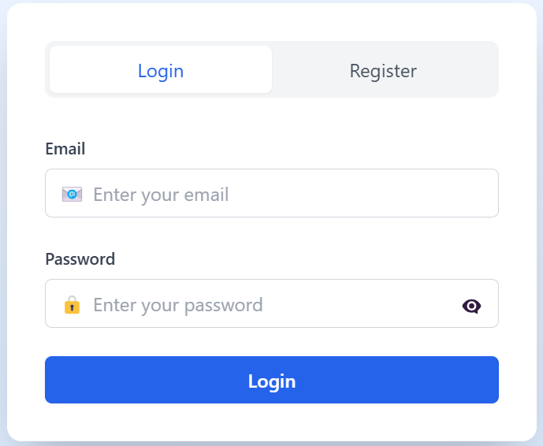
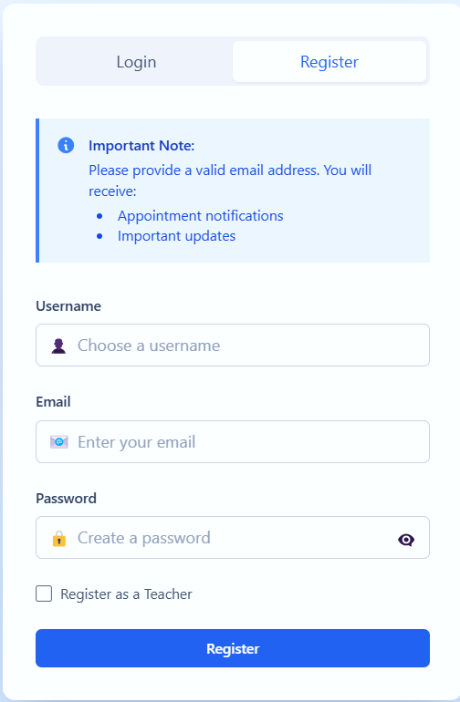
Login & Register:-
Login:
Allows registered users (students and teachers) to securely access their accounts using their credentials. Teachers can manage appointments, while students can view and book them.
Register:
Enables new users to sign up by providing essential details such as name, email, and role (student or teacher). Admin approval may be required for account activation.
Implementing best practices in scheduling includes setting clear guidelines, maintaining open communication, and regularly updating schedules. These practices ensure that both teachers and students are on the same page and can plan accordingly.

Slide 8
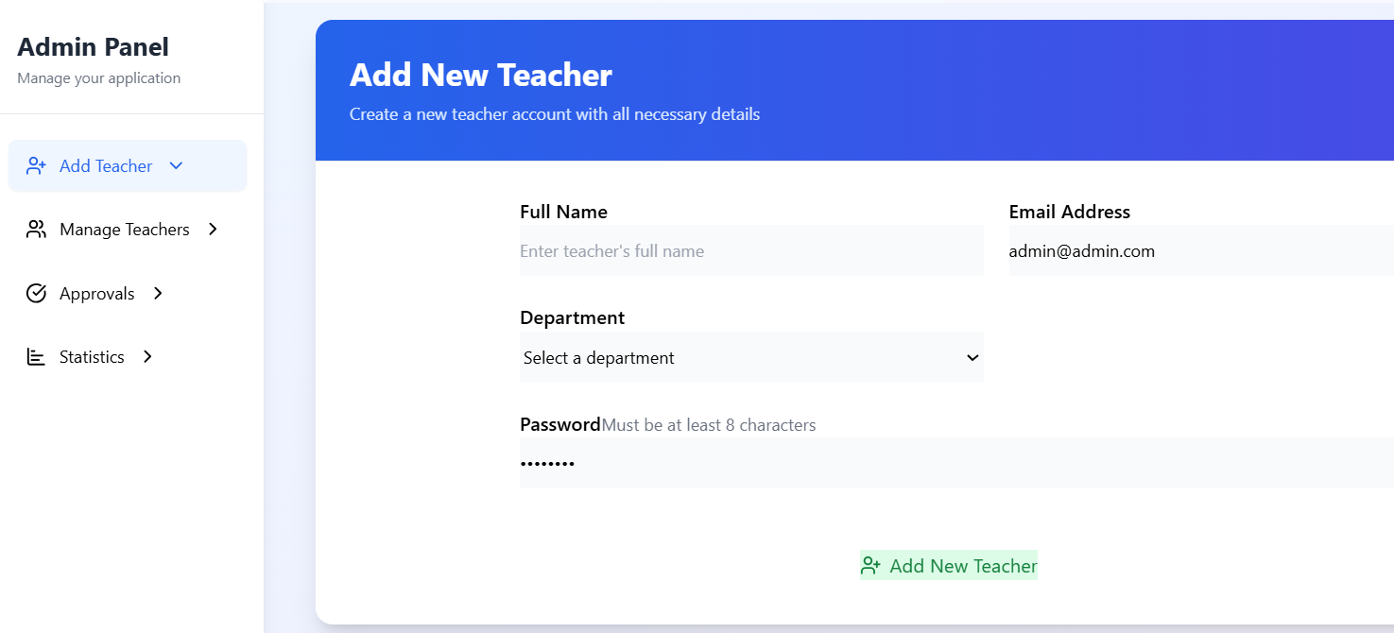
Add, update, and delete teacher information.
Approve and manage Teachers registrations and can view statistics.
Admin Module :-
Admin Credentials:
Email: admin@admin.com
Password: admin123

Slide 9
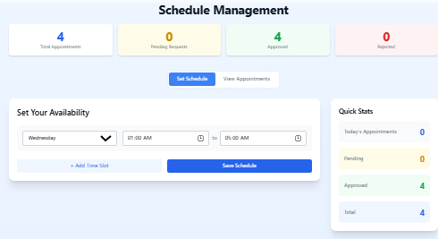
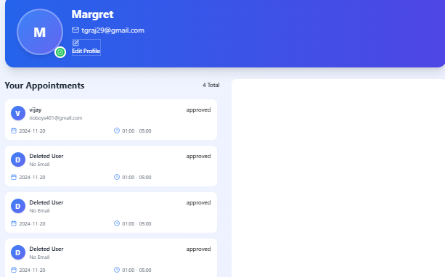
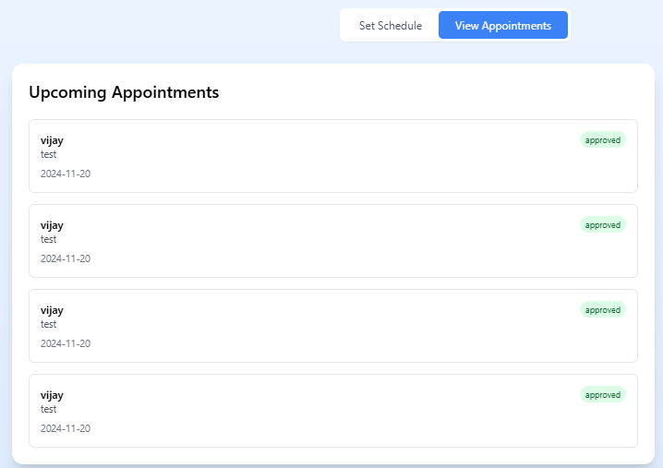
Teachers Module :-
Login to the system.
Schedule, approve and cancel appointments.
Send email alerts to students.
View messages and students appointments.

Slide 10
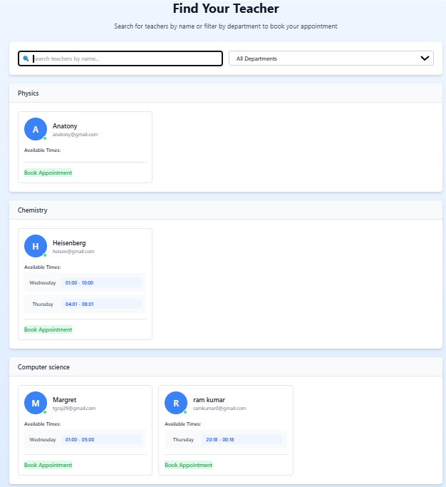
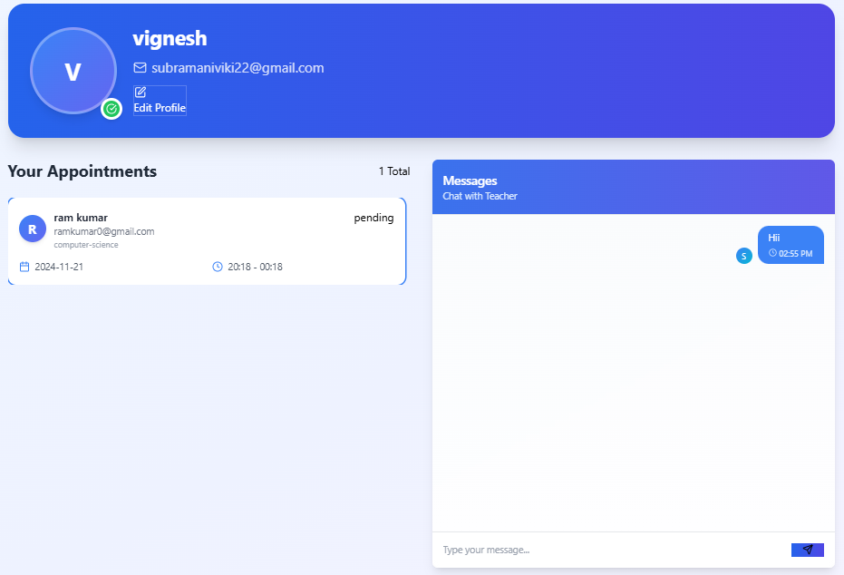
Student Module :-
Register for system access.
Login to book appointments and sends messages.
Students can choose their Teachers based on there needs.

Slide 11

Benefits :-
Simplifies communication between students and teachers.
Allows scheduling and managing appointments remotely.
Reduces manual effort in handling schedules.
Provides real-time updates and notifications.

Slide 12

Features :-
Accessibility: Anytime, anywhere access via the internet.
User-Friendly Interface: Simplified navigation for all users.
Email Notifications: Automated alerts for scheduled appointments.
Messaging System: Allows students to communicate appointment details.
Dynamic Scheduling: Teachers can manage and adjust appointments easily

Slide 13

Conclusion
The Student-Teacher Appointment Booking System streamlines scheduling and communication using technologies like MongoDB, Express.js, and Node.js.
It reduces manual workload, enhances productivity, and ensures accessibility for better interaction. This system is a valuable tool for improving educational processes.

Slide 14
Thanks!

